Slide 1
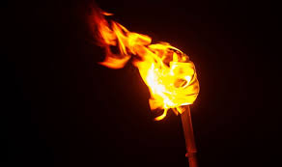
Who is in Charge?
When the visions of man go against the plan of God
John 18:1-12
Preached by Dr. Jim Harmeling at Crossroads International Church Singapore • CICFamily.com Uploaded by Dr. Rick Griffith • Jordan Evangelical Theological Seminary Files in many languages for free download at BibleStudyDownloads.org

Slide 2
Do you fight against the discomfort and changes involved with God’s rule? (vs. 1-3)

Slide 4
Do you fight against the discomfort and changes involved with God’s rule? (vs. 1-3)
Do you recognize God’s power to eliminate human protest against His rule? (vs. 4-9)

Slide 5
2 Kings 1
1st 50

Slide 6
2 Kings 1
1st 50

Slide 7
2 Kings 1
2nd 50

Slide 8
2 Kings 1
2nd 50

Slide 9
2 Kings 1
3rd 50

Slide 10
Do you fight against the discomfort and changes involved with God’s rule? (vs. 1-3)
Do you recognize God’s power to eliminate human protest against His rule? (vs. 4-9)
Do you impulsively promote your small, self-centered kingdom? (vs. 10-12)

Slide 11
Serious Questions to Ask
Are you attempting something to fulfill your vision for your future apart from God’s will or glory?
Are you forcing something that God deliberately blocks?
Are you missing the bigger picture of what God accomplishes through His Son?
Are you impulsively moving forward in some direction of life because God does not appear powerful to you?
Are you willing to accept God’s will for life even if it requires pain and delay in success?

Slide 12
Black

Slide 13
NT Preaching link at BibleStudyDownloads.org
Get this presentation and notes for free!
Notes:
NT Preaching (np)

